Slide 1
What’s in the server side?
GET, POST, PUT, DELETE methods
Request
?
Frontend
API
(Controller)
Response

Slide 2
Server Side
GET, POST, PUT, DELETE methods
Database design
Request
Frontend
API
(Controller)
Model
Response
Database
Request
Response

Slide 3
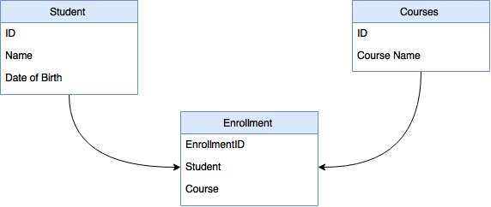
Model
Tables
Attributes
Your database design!
Tables, attributes and relationships
Relationships

Slide 4
Server Side
GET, POST, PUT, DELETE methods
Database design
Request
Frontend
API
(Controller)
Model
Response
Database
Request
Response

Slide 5
Controller
Basically your API
GET, POST, PUT, DELETE methods
Talks to your database
Students Controller
GET Students POST Students PUT Students DELETE Students
Get Students
Frontend
Students List
Database
API

Slide 6
Server Side
GET, POST, PUT, DELETE methods
Database design
Request
Frontend
API
(Controller)
Model
Response
Database
Request
Response

